Slide 1

Design Concepts and programming Tips
Modeling!
FW 508, Fall 2022

Slide 2
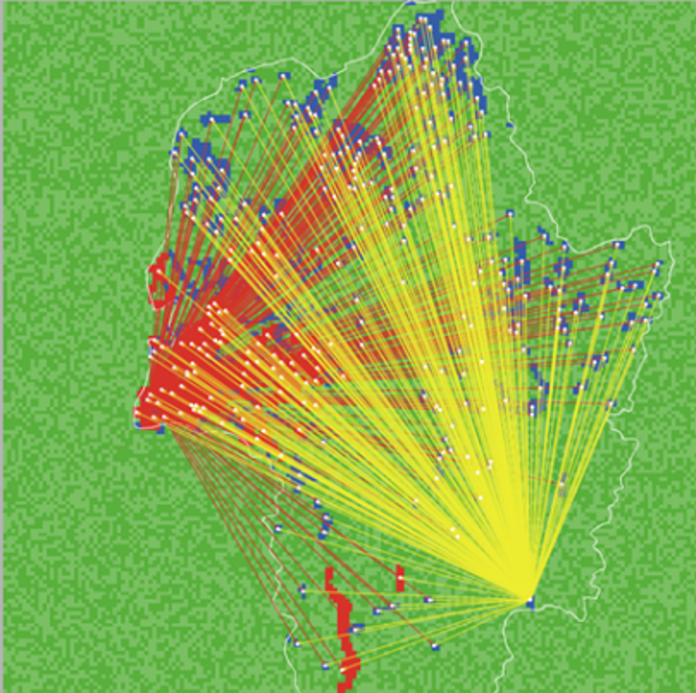
Overview
DESIGN
Emergence
Sensing
Interactions
PROGRAMMING TIPS

Slide 3
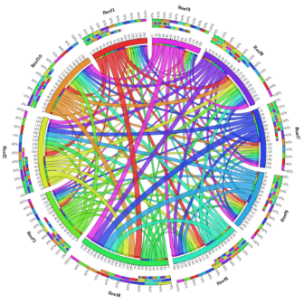
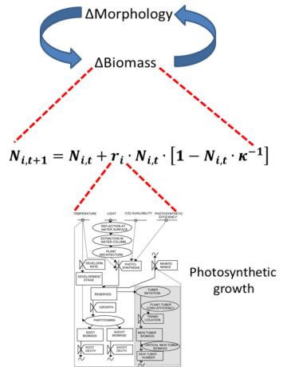

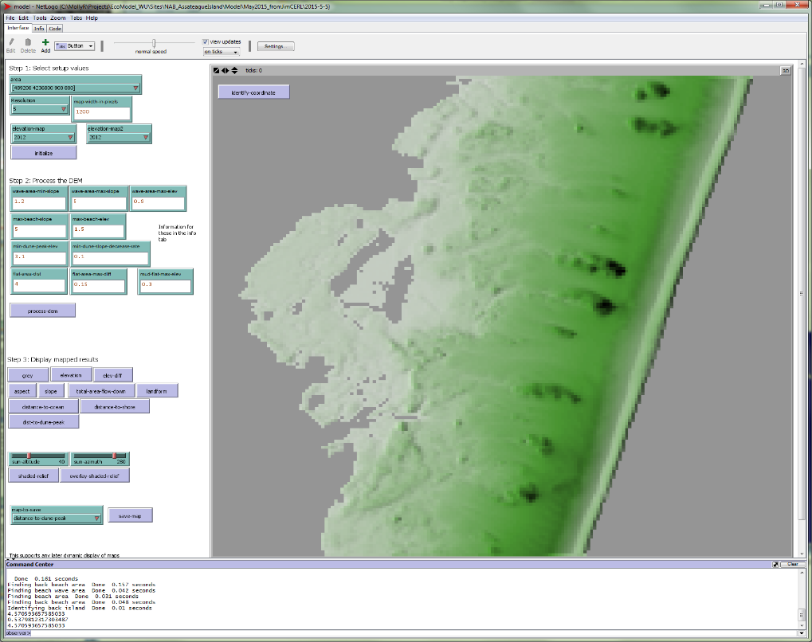

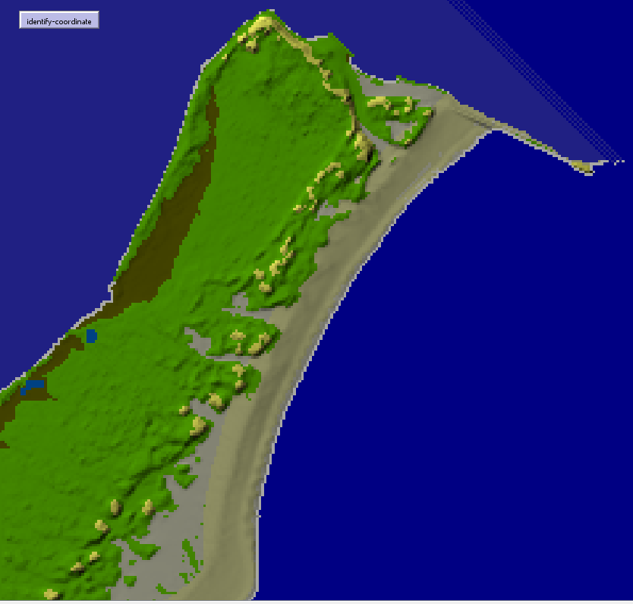
Design
SETTING UP YOUR MODEL
Model design requires careful thinking about how agents interact, sense each other, and the potential emergent properties
Design concepts should be documented prior to building model (conceptual models, pseudocode, etc).

Slide 4

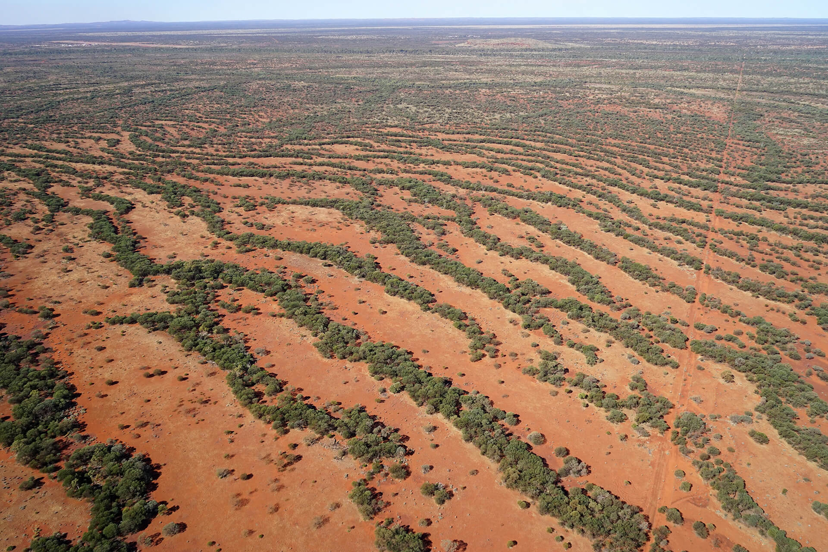
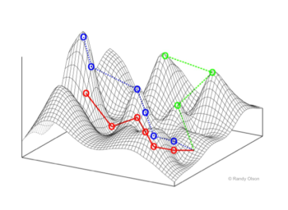
Emergence
What is an emergent property?
More than the sum of individual properties
Different type of results than individual properties
Cannot easily be predicted from interactions
https://www.youtube.com/watch?v=CipO1XGh4QM

Slide 5
Sensing & Interaction
How is information obtained by agents?
Do they just know it? Have to gather it?
Is it a property of other agents, patches, or global environment?
Thought exercise: Assume these agents needed water at a certain time of year to breed. What would they have to sense? What are the interactions? How would they get information about time of year? What are the global variables? Patch? Turtle?
Gathering information
Time of year
X₁Y₁
Water
X₁Y₂
No Water
Code:
Individual
Female
Adult
X₁Y₁
Individual
Male
Adult
X₁Y₂

Slide 6
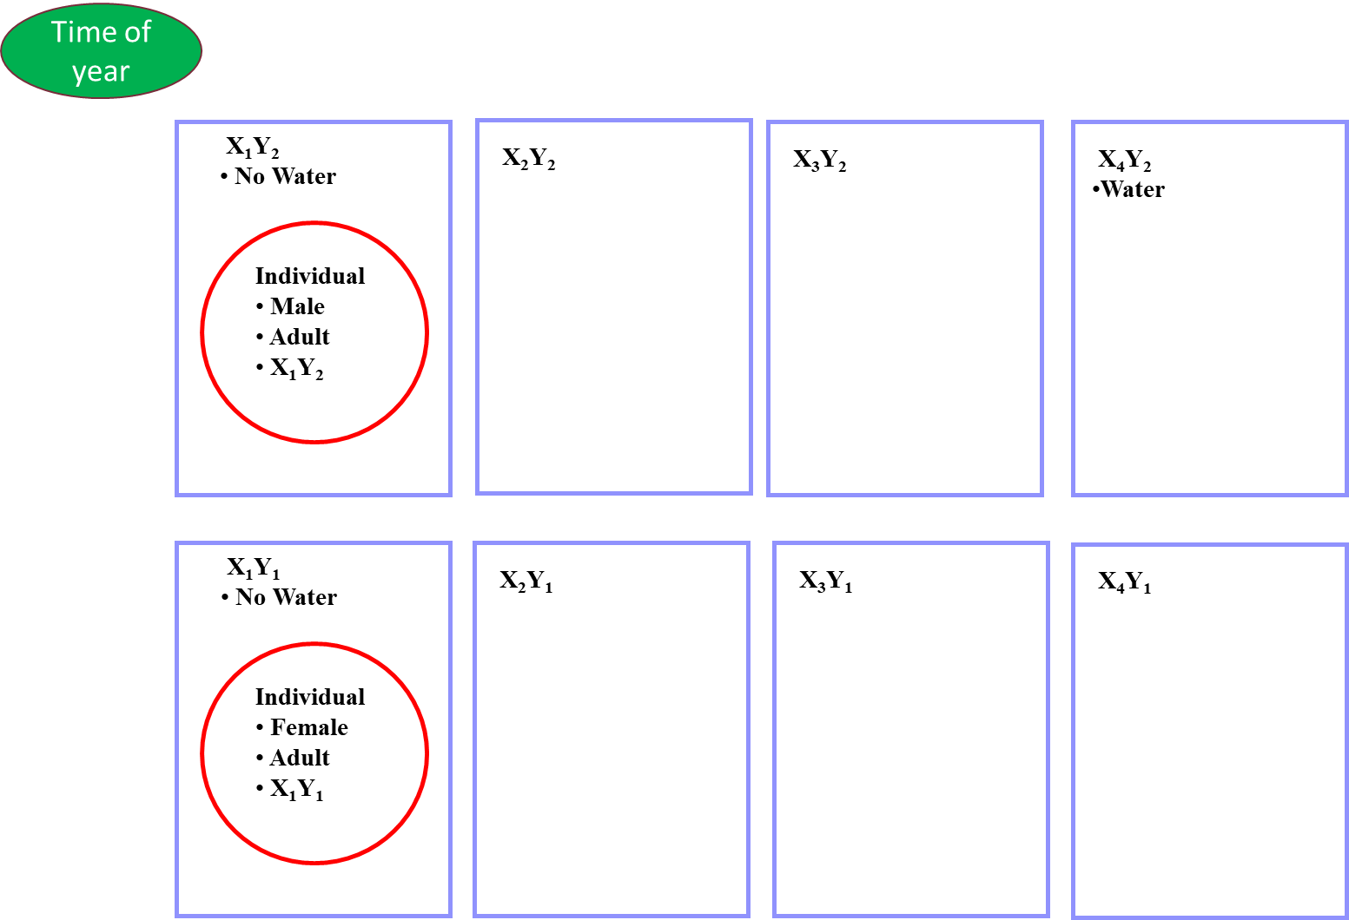
WHAT ABOUT THIS?
Code:

Slide 7

Heroes and cowards
I ain’t scared!

Slide 8
What will happen?
In a group of people, each picks a friend and an enemy. In the first phase of the game, people act like cowards and move to keep their friend between them and their enemy. In the second phase, people act as heroes and move between their friends and enemies.

Slide 9
Simple rules can lead to complex patterns
Keep it simple
ABMs often start as series of if statements
Start simple, add complexity once simple version works
Write pseudocode, draw things out, etc
Trial and error!

Slide 10
Coding in Netlogo
Lessons learned

Slide 11
Netlogo coding tricks
PRACTICE!
Create agentsets and lists when needed to optimize loops
Agentsets
Let foo turtles with [color = “blue”]
Ask foo [commands]
Processed in random order
Lists
Let temp list (random 10) (random 9) (“test”)
Show list [10 9 “test”]
Processed in order

Slide 12
Netlogo coding tricks
PRACTICE!
All netlogo agentsets and lists start with 0!
Use show and print to verify code
Show count foo
5
Print (word “total number of blue turtles: ” count foo)
Total number of blue turtles: 5

Slide 13
Netlogo coding tricks
PRACTICE!
Develop utility functions/reporters if you find yourself using code repeatedly (i.e., create your own primitives)
to-report util-random-range [min-extreme max-extreme] ;generates random integer between two values
report random (max-extreme - min-extreme + 1) + min-extreme
end
to-report util-frequency [an-item a-list] ;counts number of times an item appears in list
report length (filter [ i -> i = an-item] a-list)
end

Slide 14
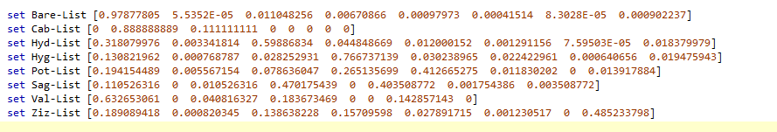
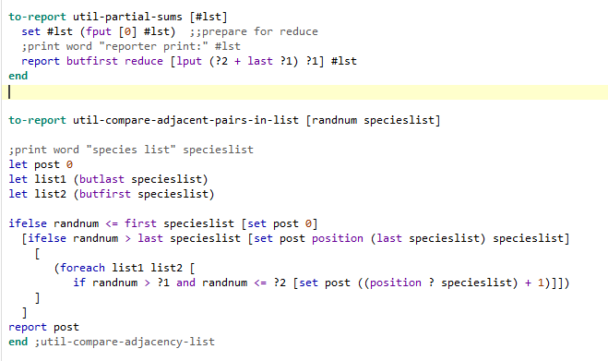
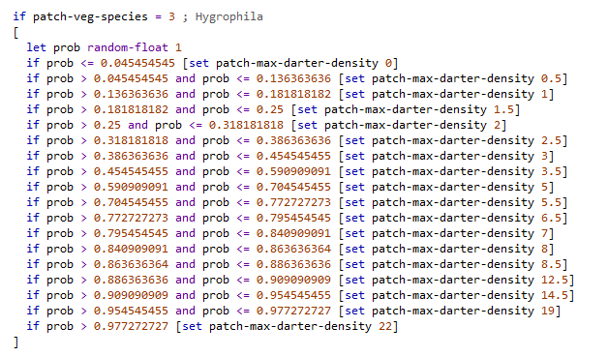
Netlogo coding tricks
PRACTICE!
Brute force coding does work and shouldn’t be ignored (but there is probably a primitive or command that will help)
273 lines of code
30 lines of code

Slide 16

SUMMARY
EMERGENCE
Key for analyzing complex ecological systems
Patterns are not likely predictable from individual
WE’RE GETTING OUR WORK DONE
We finished the consolidation project
WE’RE DELIVERING FOR OUR CUSTOMERS
Customer satisfaction increased from 70 to 80%
OUR CUSTOMERS KEEP COMING BACK
We increased customer retention by 4%

Slide 17



THANK YOU
VICTORIA LINDQVIST
+1 (589) 555-0199
victoria@fabrikam.com
WWW.FABRIKAM.COM

